Slide 1


Causal Inference in observational studies
Kun Kuang (况琨)
Associate Professor
College of Computer Science
Zhejiang University
Homepage: https://kunkuang.github.io/

Slide 2


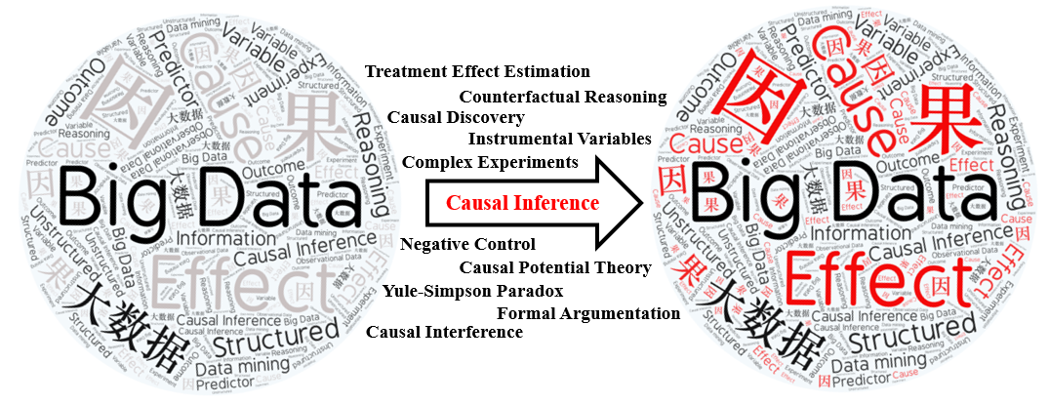

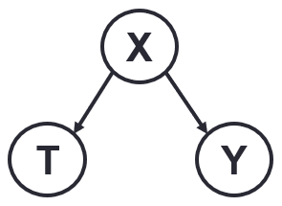
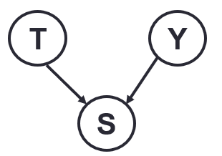
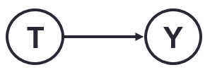
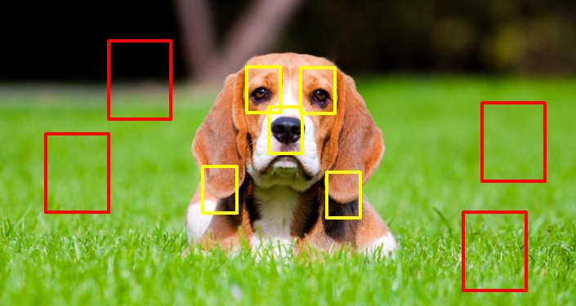

Associate Professor, Zhejiang University
Vice Director of AI Department
Received Ph.D. from Tsinghua University @ 2019
Visited Stanford @ 2017 (worked with Prof. Susan Athey)
Research: Causal Inference, Explainable AI, and Causality Regularized Machine Learning
Draw Causation from Big Data
Causal Inference
Sources of Correlation
Causation
Confounding
Sample Selection
Causal Representation/Learning
Stable
Actionable
Explainable
Spurious Correlation: T is correlated with Y ignoring X
Spurious Correlation: T is correlated with Y given S
Causality Regularized
Stable & Explainable
Fair & Actionable
Machine Learning

Slide 3


Decision Making with Causality
Causal Effect Estimation is necessary for decision making!
Causal effect estimation plays an
important role on decision making!
Notes:
A single/double/triple-blind experiments
We always have many decision to make in our life, and the causal effect estimation is very necessary for decision making in many fields. For example, in medical field, we need causal effect of a new drug before deciding to release it or not; in social marketing, marketers can easily decide whether to promote a market strategy or not with its causal effect. Therefore, causal effect estimation plays an important role on decision making.

Slide 4
A practical definition
Definition: T causes Y if and only if
changing T leads to a change in Y,
keep everything else constant.
Causal effect is defined as the magnitude by which Y is changed by a unit change in T.
Two key points: changing T, keeping everything else constant
*Interventionist definition [http://plato.stanford.edu/entries/causation-mani/]
Notes:
Two key points for causal effect estimation:
Changing T
Keeping everything else constant

Slide 5

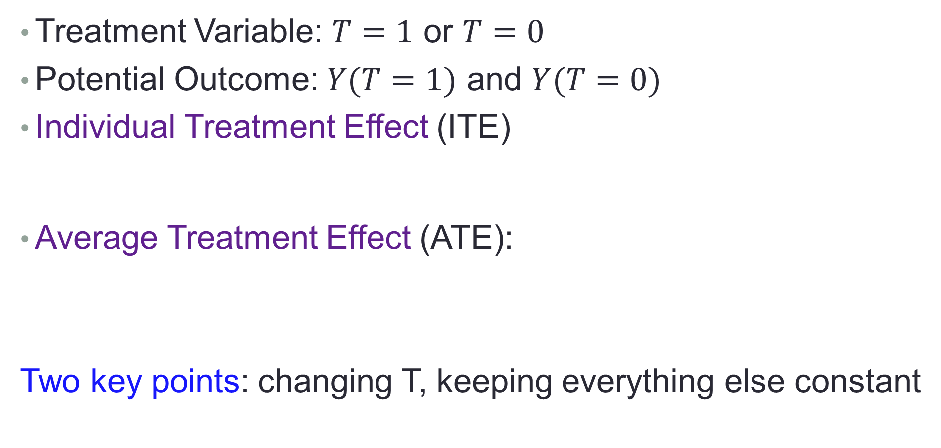
Treatment Effect Estimation
Treatment Variable: $T=1$ or $T=0$
Potential Outcome: $Y(T=1)$ and $Y(T=0)$
Individual Treatment Effect (ITE)
Average Treatment Effect (ATE):
Two key points: changing T, keeping everything else constant
$$ITE(i)=Y_{i}\left(T_{i}=1\right)−Y_{i}\left(T_{i}=0\right)$$
$$ATE=E[Y\left(T=1\right)−Y\left(T=0\right)]$$
Notes:
Placebo
From the definition of ATE, we know there is a counterfactual problem. That is, for each unit, we can only observe one of two potential outcomes, treated or control, not both.

Slide 6



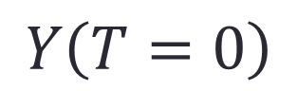
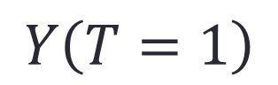
Ideal Solution: Counterfactual World
Reason about a world that does not exist
Everything is the same on real and counterfactual worlds, but the treatment is different
$$Y\left(T=1\right)$$
$$Y\left(T=0\right)$$

Slide 7





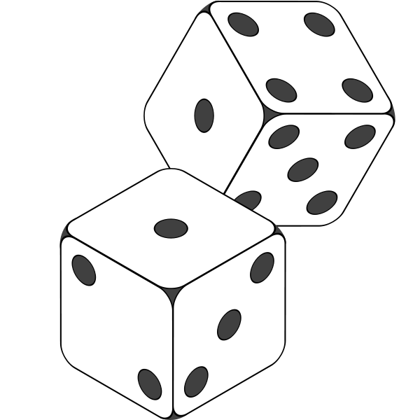



Randomized Experiments are the “Gold Standard”
Drawbacks of randomized experiments:
Cost
Unethical

Slide 8
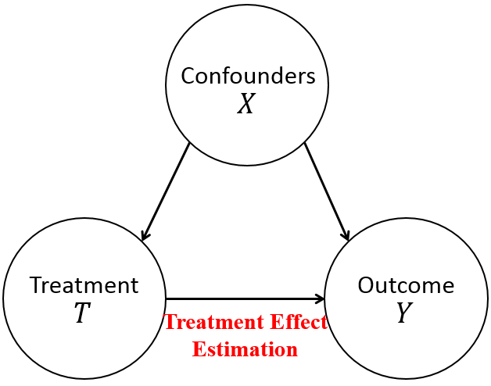
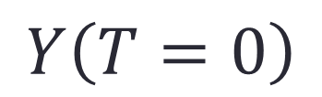
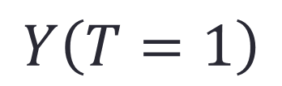
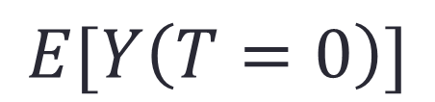
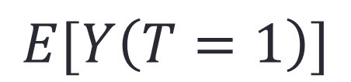
Causal Inference with Observational Data
$$Y\left(T=1\right)$$
or
$$Y\left(T=0\right)$$
Counterfactual problem:
In observational data, we have units with different T:
Can we estimate ATE by directly comparing the average outcome between groups with T=1 and T=0?
No, because confounders X might not be constant
Two key points:
Changing T (T=1 and T=0)
Keeping everything else (Confounder X) constant
$$E[Y\left(T=1\right)]$$
or
$$E[Y\left(T=0\right)]$$
Notes:
In observational data, we also have units with different treatment T, but their treatment status might be affected by their other features, we say confounders X, leading to the different distribution on confounders.
For example, for a very expensive medication, taking or not majorly depends on the patients’ income, leading to the distribution of income variable become different between treated and control groups.
Hence, if we want to estimate the causal effect from observational data, we need to balance confounders’ distribution.

Slide 9
Causal Inference with Observational Data
$$Y\left(T=1\right)$$
or
$$Y\left(T=0\right)$$
Counterfactual problem:
In observational data, we have units with different T:
Can we estimate ATE by directly comparing the average outcome between groups with T=1 and T=0?
No, because confounders X might not be constant
Two key points:
Changing T (T=1 and T=0)
Keeping everything else (Confounder X) constant
$$E[Y\left(T=1\right)]$$
or
$$E[Y\left(T=0\right)]$$
Balancing Confounders’ Distribution
Notes:
In observational data, we also have units with different treatment T, but their treatment status might be affected by their other features, we say confounders X, leading to the different distribution on confounders.
For example, for a very expensive medication, taking or not majorly depends on the patients’ income, leading to the distribution of income variable become different between treated and control groups.
Hence, if we want to estimate the causal effect from observational data, we need to balance confounders’ distribution.

Slide 10
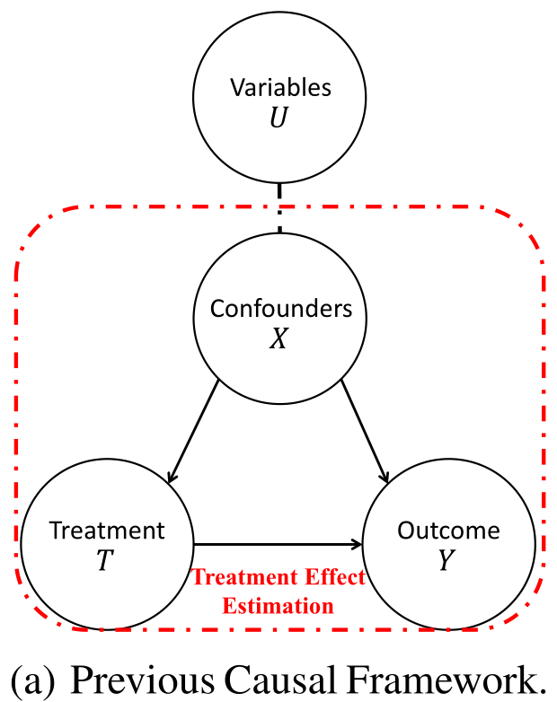
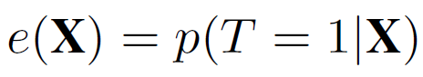
Related Work
Matching Methods
Exactly Matching, Coarse Matching
Poor performance in high dimensional settings
Propensity Score based Methods
Propensity score
Matching, Weighting, Doubly Robust
Treat all observed variables as confounders, and ignore the non-confounders
Mainly designed for binary treatment
Notes:
To balance confounder, some researchers proposed matching methods, including the exactly matching and coarse matching, which match units with the same confounders. But these methods have poor performance in high dimensional settings.
Then, Rubin introduced the propensity score to summarize the information required to balance the confounders.
And many approaches are proposed based on propensity score, including propensity score matching, inverse propensity weighting and doubly robust method.
However, these methods treat all observed variables as confounders, which make the estimated treatment effect imprecise, because some variables could be non-confounders, for example the adjustment variables. Moreover, propensity score estimation need model specification.

Slide 11
New challenges in Big Data era
Automatically separate confounders
Not all observed variables are confounders
Data-Driven Variables Decomposition (D²VD)
Remove unobserved confounding bias
Not all confounders are observed
Automatic Instrumental Variable Decomposition (AutoIV)
Continuous treatment effect estimation
Treatment variables are not always binary
Generative Adversarial De-confounding (GAD)
Notes:
However, in big data scenario, there are always a large number of observed variables, but not all these variables are confounders, and different confounders would contribute unequally to confounding bias in data. Therefore, in big data era, to precisely estimate treatment effect, we are facing following challenges, how to automatically separate confounders, and differentiate different confounders. To address these challenges, we proposed DVD and DCB algorithms.

Slide 12
New challenges in Big Data era
Automatically separate confounders
Not all observed variables are confounders
Data-Driven Variables Decomposition (D²VD)
Remove unobserved confounding bias
Not all confounders are observed
Automatic Instrumental Variable Decomposition (AutoIV)
Continuous treatment effect estimation
Treatment variables are not always binary
Generative Adversarial De-confounding (GAD)
Notes:
However, in big data scenario, there are always a large number of observed variables, but not all these variables are confounders, and different confounders would contribute unequally to confounding bias in data. Therefore, in big data era, to precisely estimate treatment effect, we are facing following challenges, how to automatically separate confounders, and differentiate different confounders. To address these challenges, we proposed DVD and DCB algorithms.

Slide 13
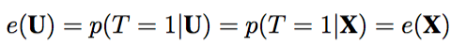
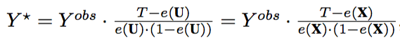
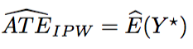
Previous Causal Framework
Treat all observed variables U as confounders X
Propensity Score Estimation:
Adjusted Outcome:
IPW ATE Estimator:
Notes:
In previous causal framework, to estimate the propensity score, they treat all observed variables U as confounders X. Then, they adjust the outcome and samples with inverse of propensity score for confounder balancing, and treatment effect estimation.

Slide 14
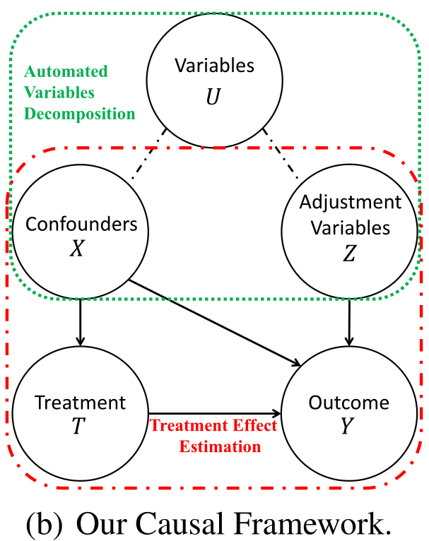
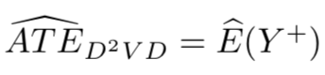
Our Causal Framework
Separateness Assumption:
All observed variables U can be decomposed into two sets: Confounders X, and Adjustment Variables Z
Propensity Score Estimation:
Adjusted Outcome:
Our D²VD ATE Estimator:
Kuang K, Cui P, Li B, et al. Treatment effect estimation with data-driven variable decomposition [C]//AAAI, 2017 (and extended to TKDE 2020)
Notes:
Comparing with previous causal framework, we propose a new causal framework.
In our causal framework, we assume all the observed variables U can be decomposed into three sets:
(1) Confounders X, which are associated with the treatment T and may be causally related to the outcome Y.
(2) Adjustment Variables Z, which are causally related to outcome Y , but independent with treatment T.
With the separated confounder X, we can precisely estimate the propensity score, and with the separated adjustment variables Z, we can regressing Y on them to remove the variance of Y.
Finally, based on our adjusted outcome, we can estimate the average treatment effect by the expectation of adjusted outcome.

Slide 15
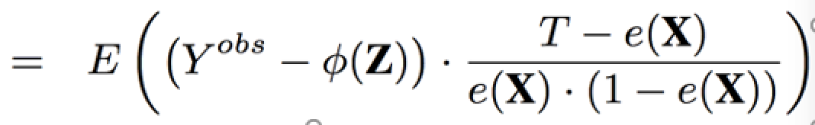
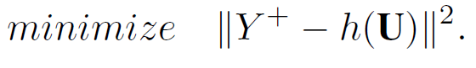
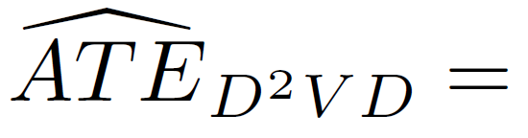
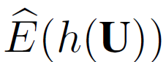
Data-Driven Variable Decomposition (D²VD)
Confounders Separation & ATE Estimation.
With our D²VD estimator:
By minimizing following objective function:
We can estimate the ATE as:
Notes:
Based on our causal framework, we proposed an data driven variables decomposition algorithm to jointly optimize confounders separation and ATE estimation.
skip
With our adjusted estimator, we can estimate the ATE by the expectation of adjusted outcome Y plus.
If we assume the treatment effect is heterogeneous and represented by function h(U), we can obtain the estimated ATE by regression out adjusted outcome Y plus against the variables U and minimizing following objective function.
Then, we can estimate the ATE by the expectation of function h(U).

Slide 16
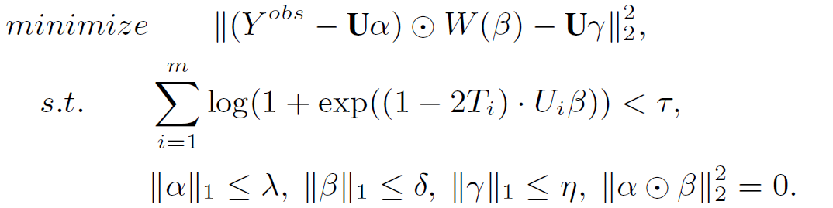
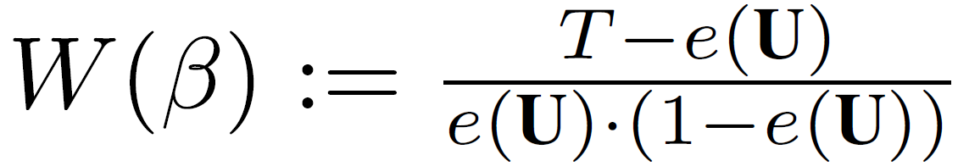
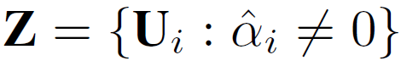
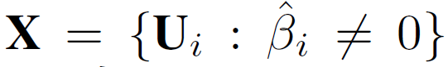
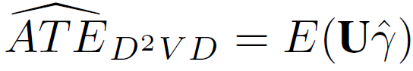
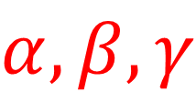
Data-Driven Variable Decomposition (D²VD)
where
Replace X, Z with U
where
Adjustment variables:
Confounders:
Treatment Effect:
$$α, β, γ$$
Notes:
Here is the details of our algorithm, where we adopt logistic regression to evaluate the propensity score with coefficient vector \beta, and adopt a linear regression to adjust outcome with coefficient vector \alpha.
Then, we employ an orthogonal regularizer on \alpha and \beta for ensuring the separation of confounders and adjustment variables.
Finally, with the optimized parameters, we can separate the adjustment variables by parameter \alpha, separate the confounders by parameter \beta, and estimate the ATE by parameter \gamma.

Slide 17
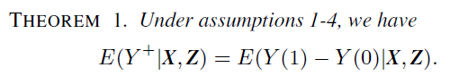
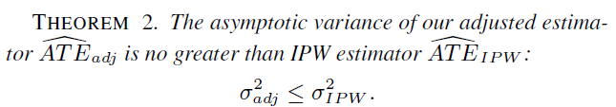
Data-Driven Variable Decomposition (D²VD)
Bias Analysis:
Our D²VD algorithm is unbiased to estimate causal effect
Variance Analysis:
The asymptotic variance of Our D²VD algorithm is smaller
Kun Kuang, Peng Cui, Hao Zou, Bo Li, Jianrong Tao, Fei Wu, and Shiqiang Yang. Data-Driven Variable Decomposition for Treatment Effect Estimation, TKDE, 2020
Notes:
Theoretically, we did both bias and variance analysis for our DVD estimator, we proved that …

Slide 18
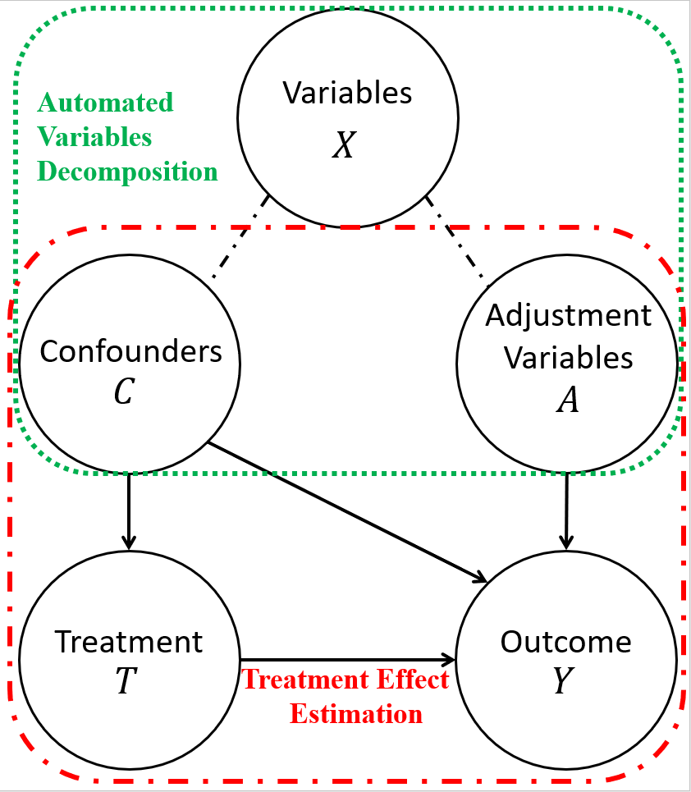
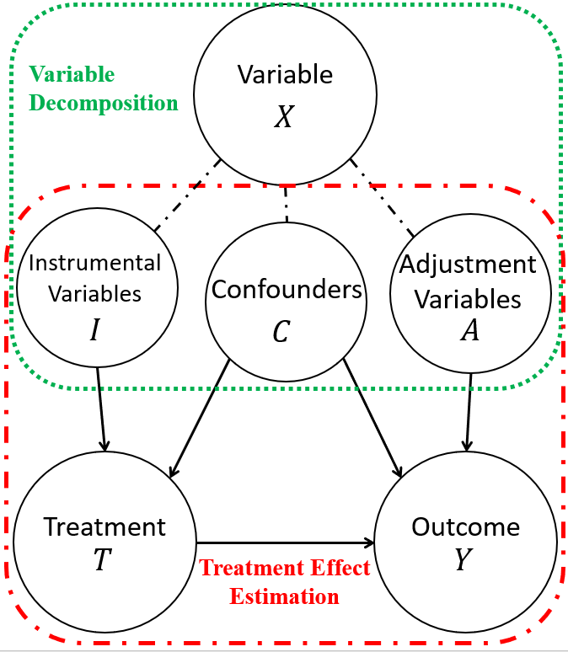
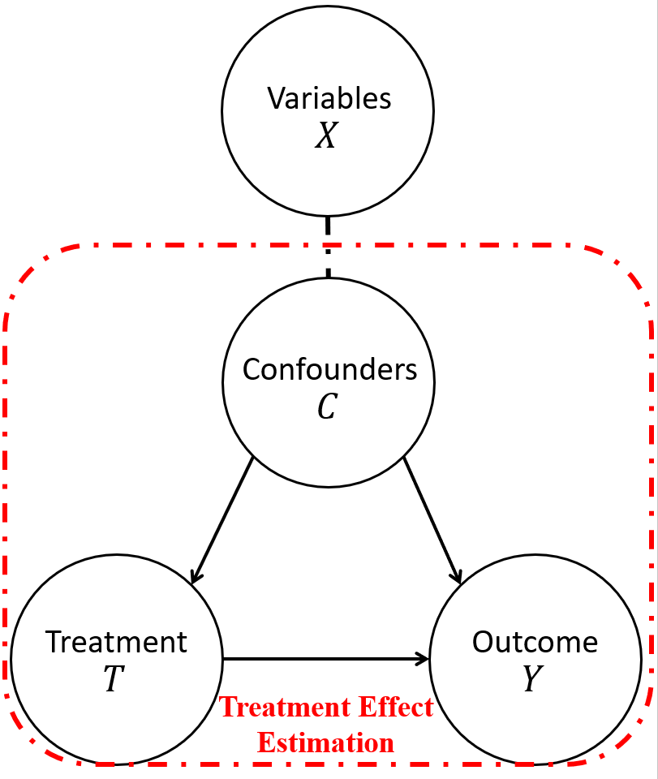
Learning Decomposed Representation for Counterfactual Inference
Wu A, Kuang K, Yuan J, et al. Learning Decomposed Representation for Counterfactual Inference[J]. arXiv preprint arXiv:2006.07040, 2020.
Notes:
Furthermore，we find that all the observed variables can be decomposed into three sets,

Slide 19
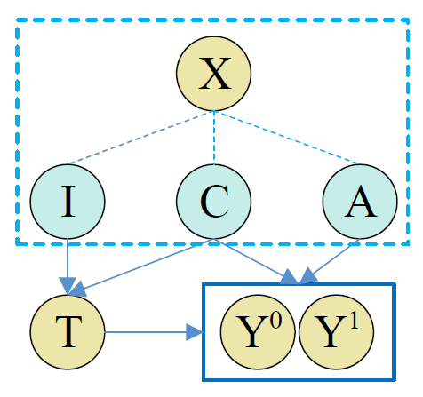
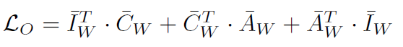
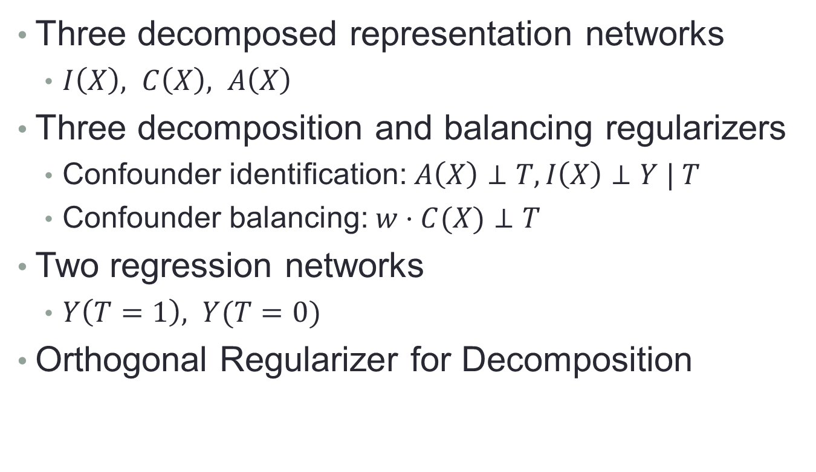
Learning Decomposed Representation for Counterfactual Inference
Three decomposed representation networks
$I\left(X\right), C\left(X\right), A\left(X\right)$
Three decomposition and balancing regularizers
Confounder identification: $A\left(X\right)⊥T, I\left(X\right)⊥Y | T$
Confounder balancing: $w⋅C(X)⊥T$
Two regression networks
$Y\left(T=1\right), Y(T=0)$
Orthogonal Regularizer for Decomposition
Wu A, Kuang K, Yuan J, et al. Learning Decomposed Representation for Counterfactual Inference[J]. arXiv preprint arXiv:2006.07040, 2020.
Notes:
Based on our new causal framework, we propose to learn the decomposed representation for each set of I C and A with considering their properties. For example, A should be independent with T and I would be independent with Y if we can balance confounders C. Finally, we can use the decomposed C and A for outcome regression, and treatment effect estimation.

Slide 20
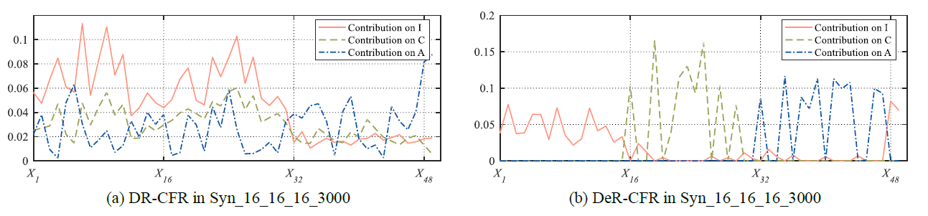
Learning Decomposed Representation for Counterfactual Inference
Wu A, Kuang K, Yuan J, et al. Learning Decomposed Representation for Counterfactual Inference[J]. arXiv preprint arXiv:2006.07040, 2020.

Slide 21
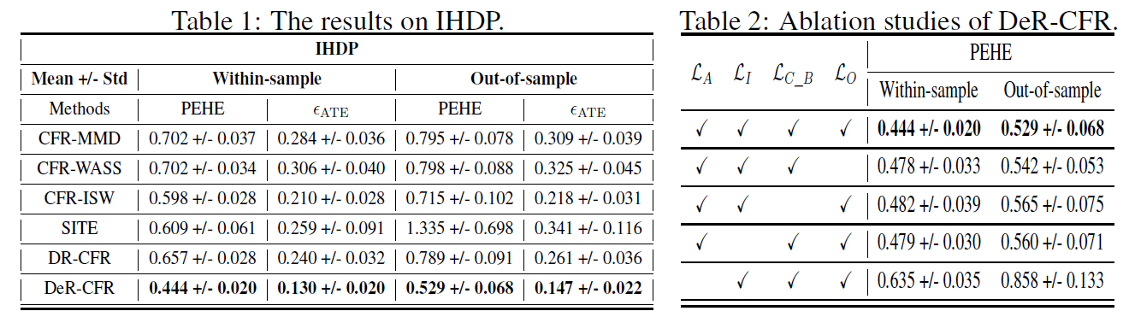
Learning Decomposed Representation for Counterfactual Inference
Wu A, Kuang K, Yuan J, et al. Learning Decomposed Representation for Counterfactual Inference[J]. arXiv preprint arXiv:2006.07040, 2020.

Slide 22
New challenges in Big Data era
Automatically separate confounders
Not all observed variables are confounders
Data-Driven Variables Decomposition (D²VD)
Remove unobserved confounding bias
Not all confounders are observed
Automatic Instrumental Variable Decomposition (AutoIV)
Continuous treatment effect estimation
Treatment variables are not always binary
Generative Adversarial De-confounding (GAD)

Slide 23
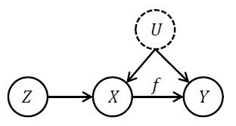
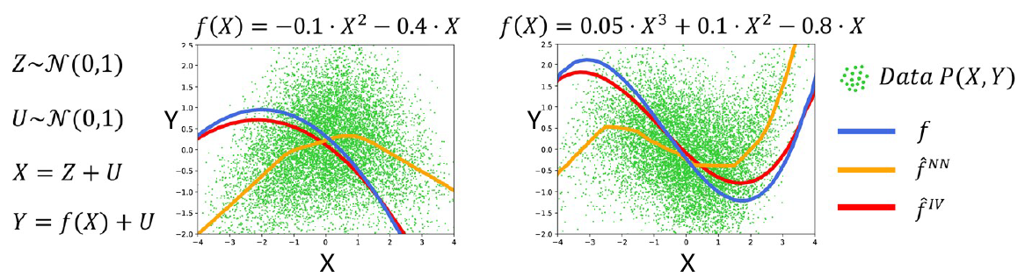
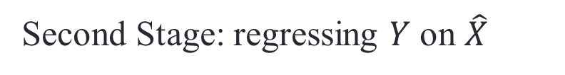

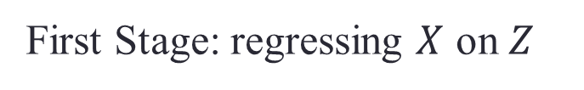
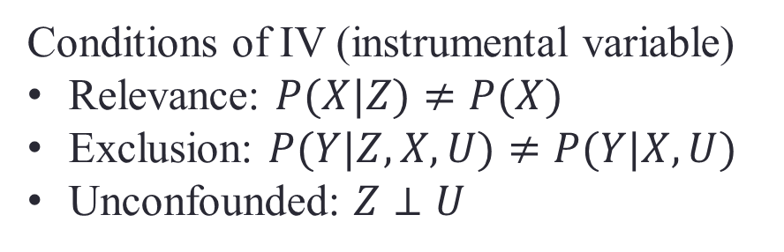
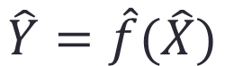
AutoIV: Counterfactual Learning with Unobserved Confounders via Automatically generating IVs
Conditions of IV (instrumental variable)
Relevance: $P(X|Z)≠P(X)$
Exclusion: $P(Y|Z,X,U)≠P(Y|X,U)$
Unconfounded: $Z⊥U$
First Stage: regressing $X$ on $Z$
$$\hat{X}=\hat{g}(Z)$$
2SLS:
Second Stage: regressing $Y$ on $\hat{X}$
$$\hat{Y}=\hat{f}(\hat{X})$$
But these methods require a pre-defined IV and find a valid IV is very hard.
Notes:
In the causal literature, one of the best ways to address unobserved confounders is instrumental variable based method. For example, Two-Stage Least Squares (2SLS) Regression. If we can find a variable Z that satisfies the conditions of IV, then, in 2SLS method, we can first use Z to regress X and obtained the predicted X hat, then regress Y on X hat to capture the causation between X and Y. Here, we use a toy example to show the effectiveness of IV based methods, which can almost recover the true function between X and Y.
But these methods require a predefined IV and finding a valid IV is very hard.

Slide 24
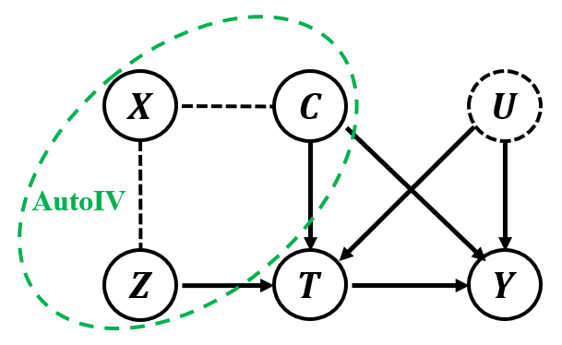
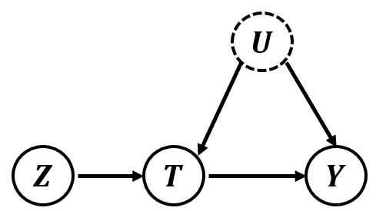
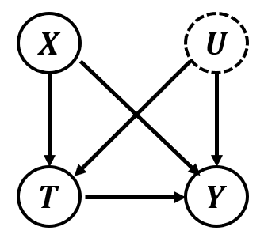

AutoIV: Counterfactual Learning with Unobserved Confounders via Automatically generating IVs
Conditions of IV
Relevance: $P(T|Z)≠P(T)$
Exclusion: $P(Y|Z,T,C)≠P(Y|T,C)$
Unconfounded: $Z⊥C$
Mutual Information
Representation Learning
Yuan J, Wu A, Kuang K, et al. Auto IV: Counterfactual Prediction via Automatic Instrumental Variable Decomposition[J]. arXiv preprint arXiv:2107.05884, 2021.
Notes:
Inspired by our previous work on variable decomposition, we propose to automatically generate a representation of IV from part of observed confounders. In our problem, we let X denote the observed confounders and U denote the unobserved confounders, then, our algorithm is designed for generating a synthetic instrumental variable Z from X by regularizing Z to satisfy the conditions of IV. The details of our AutoIV algorithm can be found in our paper.

Slide 25

AutoIV: Counterfactual Learning with Unobserved Confounders via Automatically generating IVs
Yuan J, Wu A, Kuang K, et al. Auto IV: Counterfactual Prediction via Automatic Instrumental Variable Decomposition[J]. arXiv preprint arXiv:2107.05884, 2021.
Notes:
With extensive experiments, we demonstrate the effectiveness of the automatically generated IV in our algorithm.

Slide 26
New challenges in Big Data era
Automatically separate confounders
Not all observed variables are confounders
Data-Driven Variables Decomposition (D²VD)
Remove unobserved confounding bias
Not all confounders are observed
Automatic Instrumental Variable Decomposition (AutoIV)
Continuous treatment effect estimation
Treatment variables are not always binary
Generative Adversarial De-confounding (GAD)

Slide 27


Continuous Treatment Effect Estimation
Binary Treatment
T=0 or T=1
$T⊥X$: confounder balancing
Multi-valued Treatment
T=0,1,2,…
$T⊥X$: confounder balancing
Continuous Treatment
How to make $T⊥X$ ?
Kuang K, Li Y, Li B, et al. Continuous Treatment Effect Estimation via Generative Adversarial De-confounding[J]//DMKD 2021.

Slide 28




Continuous Treatment Effect Estimation
Our goal: $T⊥X$
Variable randomly shuffle to achieve independence
Kuang K, Li Y, Li B, et al. Continuous Treatment Effect Estimation via Generative Adversarial De-confounding[J]//DMKD 2021.
Notes:
With a toy example, we find that

Slide 29




Continuous Treatment Effect Estimation
Our goal: $T⊥X$
“calibration” distribution generation
on “calibration”, we have $T′⊥X$
“calibration” distribution approximation
Observed distribution:
Learning sample weights for distribution approximation
Such that: $W T⊥W X$
sample weights $W$
Notes:
Then, by shuffling the treatment variable T, we can obtain a calibration distribution, where we have $T^{′}⊥X$. Although in our observed data, the treatment T might be not independent with X, we are thinking can we learn sample weights W to reweight the observed data for approximating the distribution of calibration data. Thus, guarantee $T⊥ X$ with sample reweighting. But the problem is how to learn the sample weights.

Slide 30






Real Data
Distinguishing
real or fake
$$D_{real}$$
Latent
Variable
Discriminator
$$Z$$
Generator
$$D_{fake}$$
Generated
fake data
Calibration Data
Distinguishing calibration
or weighted observed
$$D_{cal}$$
Sample
weight
Discriminator
$$W$$
Generator
$${W D}_{obs}$$
Weighted
observed data

Slide 31


Idea from GAN mechanism
Generative Adversarial Networks (GAN)
Generative Adversarial De-confounding (GAD)
Notes:
Our idea is inspired by the GAN mechanism. As we all know, in GAN, a generator is proposed to generate fake data and a discriminator is proposed to distinguish fake and real data. If the discriminator cannot distinguish which data is real and which is fake, then we can conclude that the distribution of fake data is similar to the real one. Following the GAN mechanism, we propose a generator to generate sample weight on observed data, and a discriminator was proposed to approximate the distribution between the calibration data and weighted observed data.

Slide 32

Generative Adversarial De-confounding (GAD)
“Calibration” distribution:
Observed distribution:
Sample weights learning with GAD
Kuang K, Li Y, Li B, et al. Continuous Treatment Effect Estimation via Generative Adversarial De-confounding[J]//DMKD 2021.
Notes:
Here is the details of our algorithm, which is similar with GAN method.

Slide 33



Continuous Treatment Effect Estimation
Notes:
Extensive experiments clearly show our algorithm can almost make the treatment T become independent with X, and achieve the best performance on treatment effect estimation.

Slide 34
Summary: New challenges in Big Data era
Automatically separate confounders
Not all observed variables are confounders
Data-Driven Variables Decomposition (D²VD)
Remove unobserved confounding bias
Not all confounders are observed
Automatic Instrumental Variable Decomposition (AutoIV)
Continuous treatment effect estimation
Treatment variables are not always binary
Generative Adversarial De-confounding (GAD)
Notes:
However, in big data scenario, there are always a large number of observed variables, but not all these variables are confounders, and different confounders would contribute unequally to confounding bias in data. Therefore, in big data era, to precisely estimate treatment effect, we are facing following challenges, how to automatically separate confounders, and differentiate different confounders. To address these challenges, we proposed DVD and DCB algorithms.

Slide 35

The official journal of the Chinese Academy of Engineering
Survey Paper：
Causal Inference（因果推理）
Kuang, K., Li, L., Geng, Z., Xu, L., Zhang, K., Liao, B., Huang, H., Ding, P., Miao, W., Jiang, Z. (2020). Causal Inference. Engineering. http://www.engineering.org.cn/ch/10.1016/j.eng.2019.08.016
Notes:
For more research topics on causal inference, such as counterfactual reasoning, causal discovery, we recommend you read our recent survey paper on causal inference.

Slide 36
Content
Kun Kuang: Estimating average treatment effect: A brief review and beyond
Lian Li: Attribution problems in counterfactual inference
Zhi Geng: The Yule–Simpson paradox and the surrogate paradox
Lei Xu: Causal potential theory
Kun Zhang: Discovering causal information from observational data
Beishui Liao and Huaxin Huang: Formal argumentation in causal reasoning and explanation
Peng Ding: Causal inference with complex experiments
Wang Miao: Instrumental variables and negative controls for observational studies
Zhichao Jiang: Causal inference with interference
Kuang, K., Li, L., Geng, Z., Xu, L., Zhang, K., Liao, B., Huang, H., Ding, P., Miao, W., Jiang, Z. (2020). Causal Inference. Engineering.
http://www.engineering.org.cn/ch/10.1016/j.eng.2019.08.016

Slide 37
Draw Causation from Big Data
Causal Inference
Sources of Correlation
Causation
Confounding
Sample Selection
Causal Representation/Learning
Stable
Actionable
Explainable
Spurious Correlation: T is correlated with Y ignoring X
Spurious Correlation: T is correlated with Y given S
Causality Regularized
Stable & Explainable
Fair & Actionable
Machine Learning
Thank You!
Kun Kuang
kunkuang@zju.edu.cn
Homepage: https://kunkuang.github.io/

